Slide 1
BM20 Rev1 FPGA Verification
Leo Zhang
2023/3/9

Slide 2
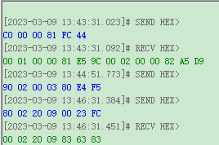
(issue4) COMN TX DIS拉高，关闭北口，同时发送读指令南口也不回复信息
Case1：wake，address，关闭S2的北口，然后single read S2

Slide 3
(issue4) COMN TX DIS拉高，关闭北口，同时发送读指令南口也不回复信息
Case2：wake，address，改变DIR，关闭S2的南口，然后single read S2

Slide 4
Digital issue waves
Snow Wang
Wed Mar 1 2023

Slide 5
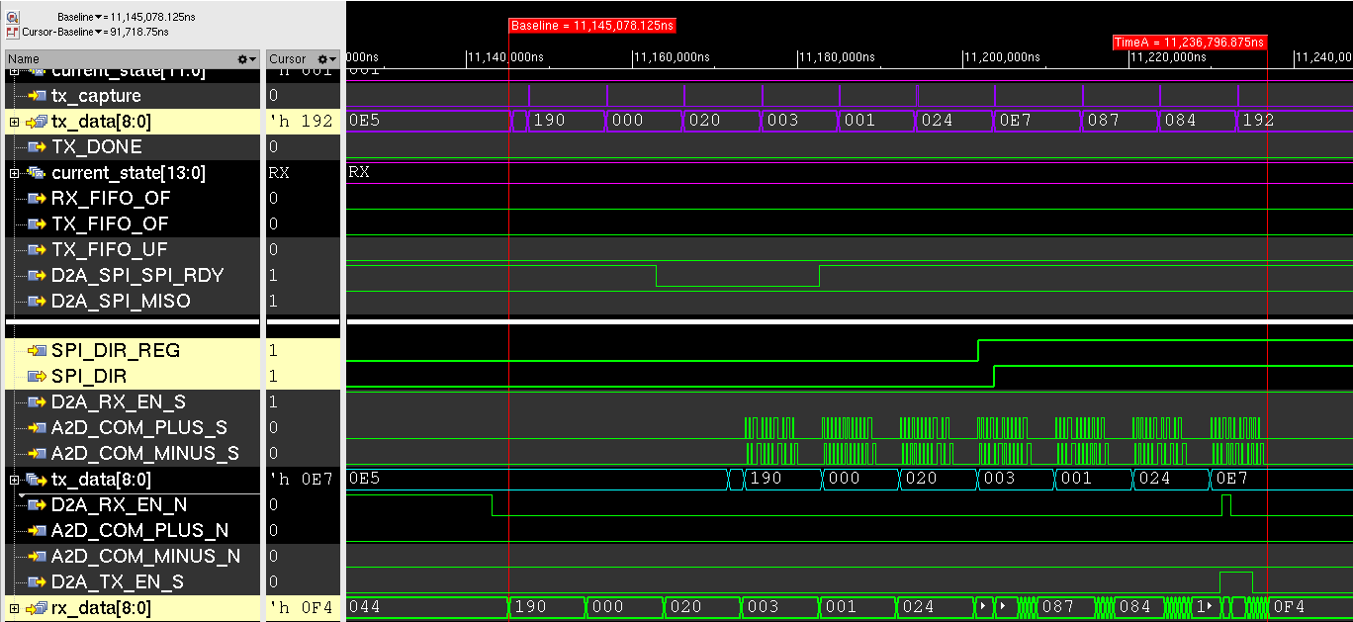
2(issue3) 4层结构，从正向切到反向Address

Slide 6
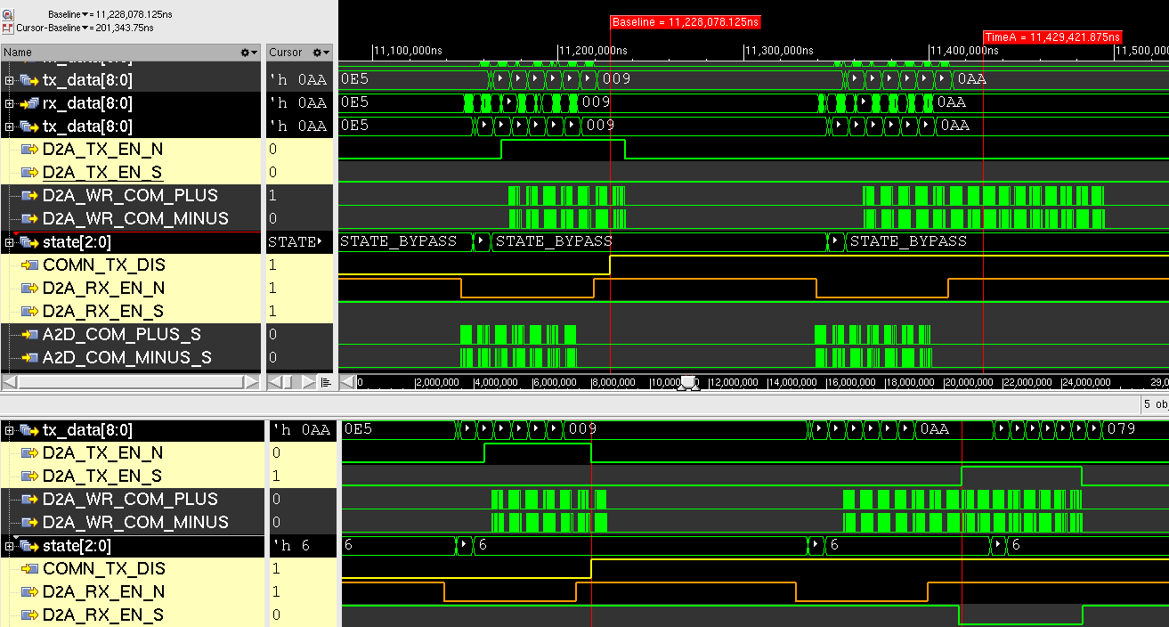
3(issue4) COMN TX DIS拉高，关闭北口，同时发送读指令南口也不回复信息
Notes:
【之前的TX_EN_N是在ｃｏｍｍａｎｄ发完才拉低的，现在是ｃｏｍｍａｎｄ没发完就能拉低。这个会影响RX_EN_S能否在该拉低的时候被拉低，比如要回复了】

Slide 7
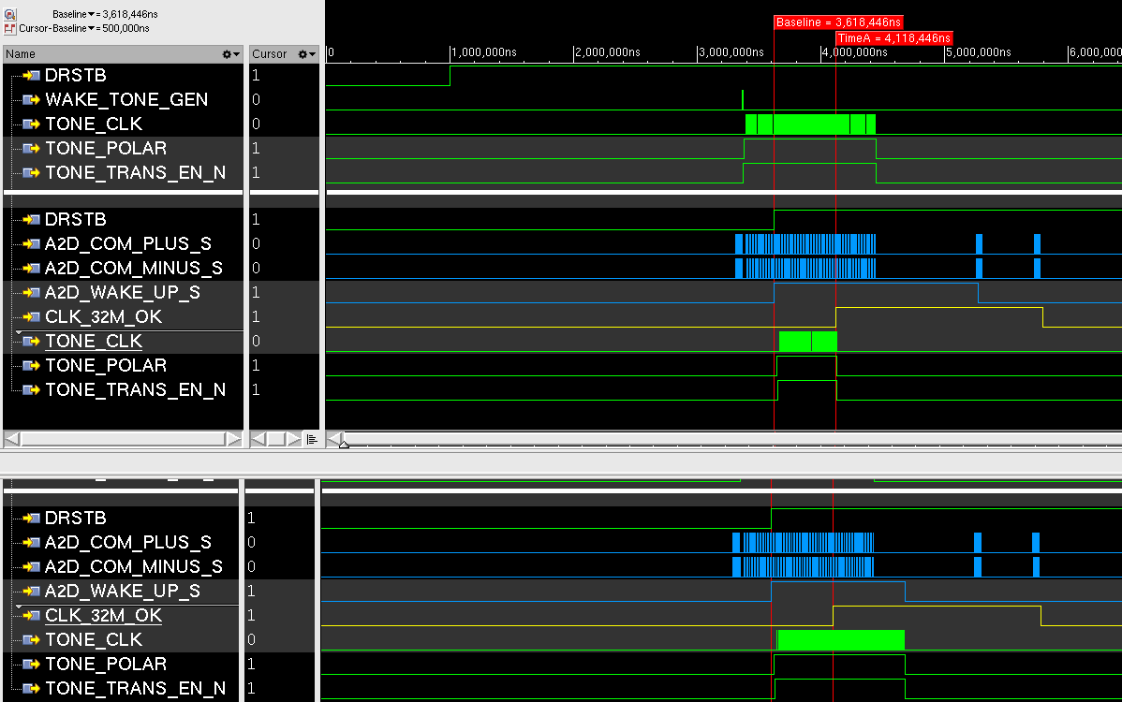
5(issue6) SLP和ACT状态收到wake Tone，不抄送
SLP状态收到wake Tone，不抄送

Slide 8
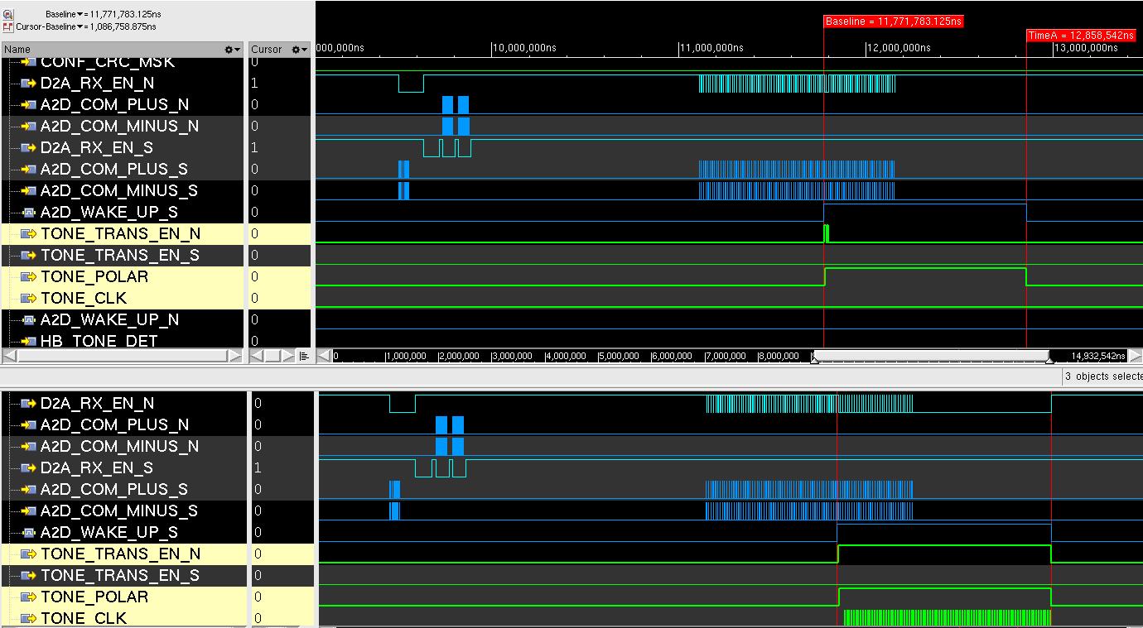
5(issue6) SLP和ACT状态收到wake Tone，不抄送
ACT状态收到wake Tone，不抄送

Slide 9
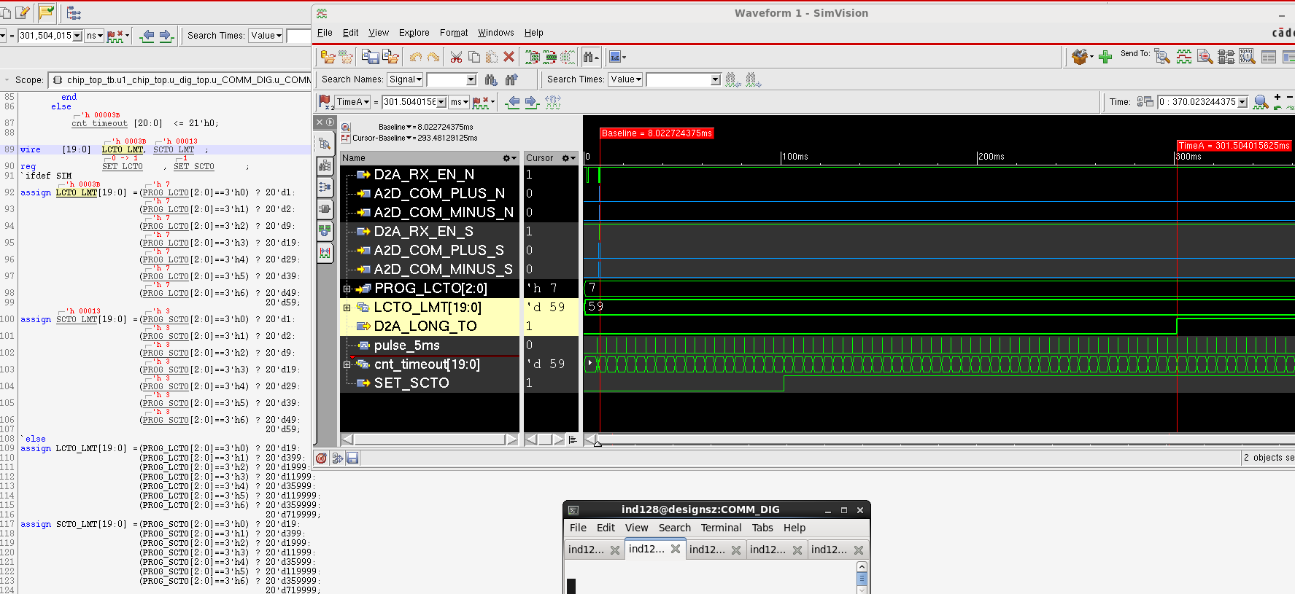
6(issue8) SCTO时间不对，实测时间比定义时间偏大8%(未复现)

Slide 10
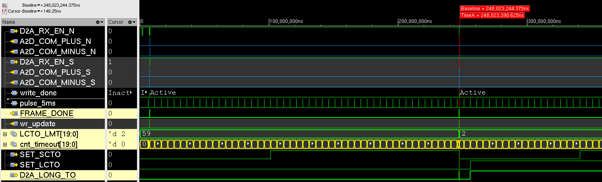
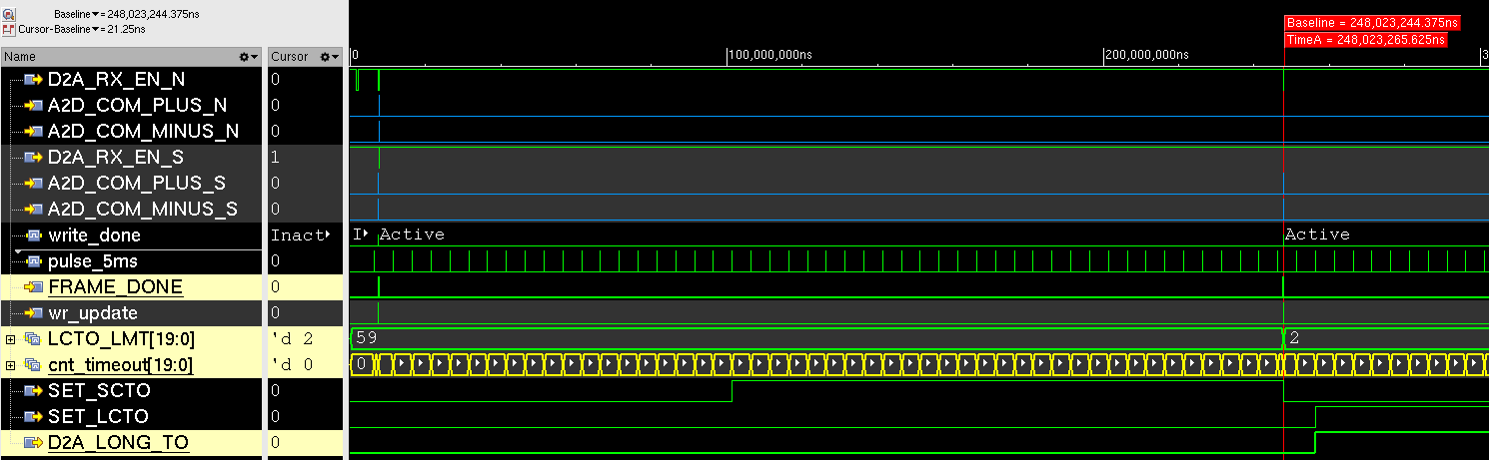
7(issue9) Act 1分钟后将LCTO改为小于1分钟，芯片立马报LCTO

Slide 11
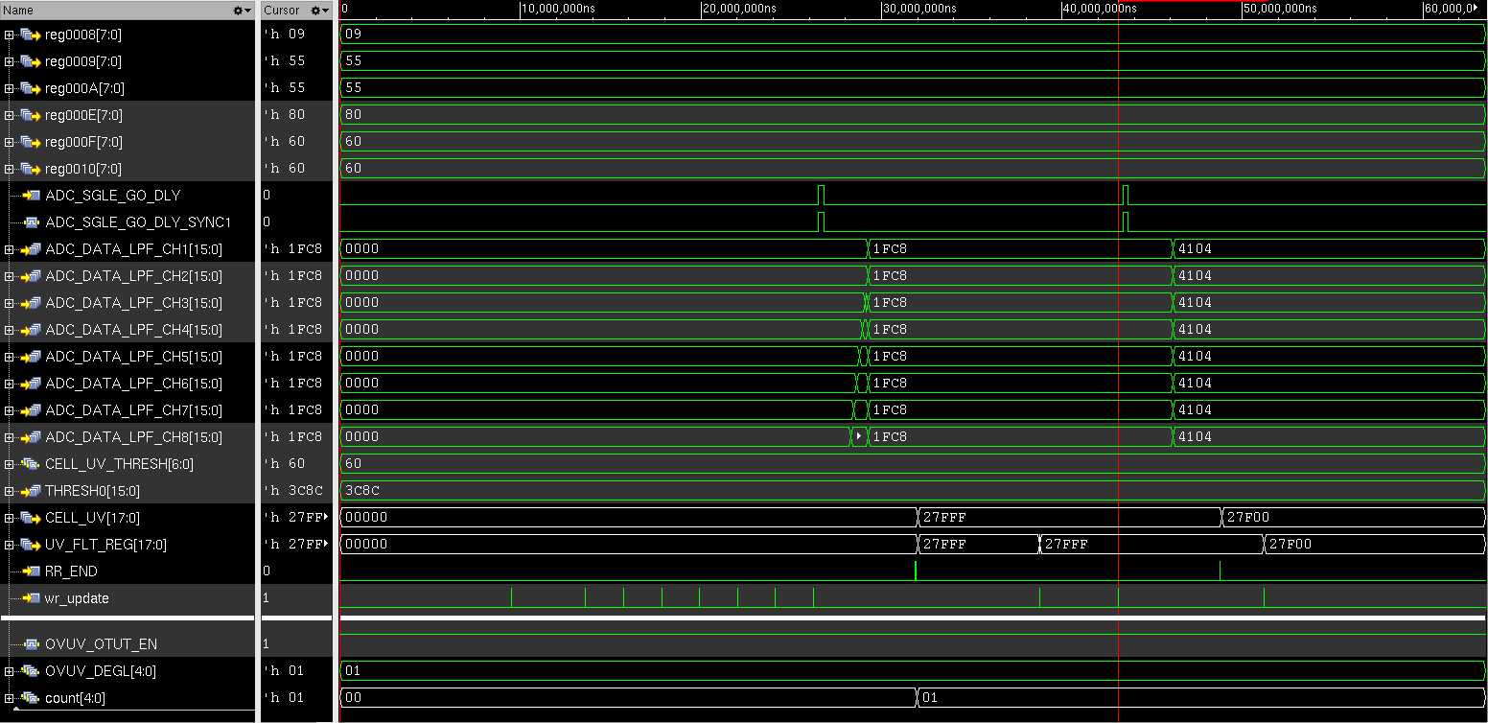
8(issue13) 1.触发后latch，无法clear。(除非故障移除)
2、当故障清除后，相应deglitch counter不能清0

Slide 12
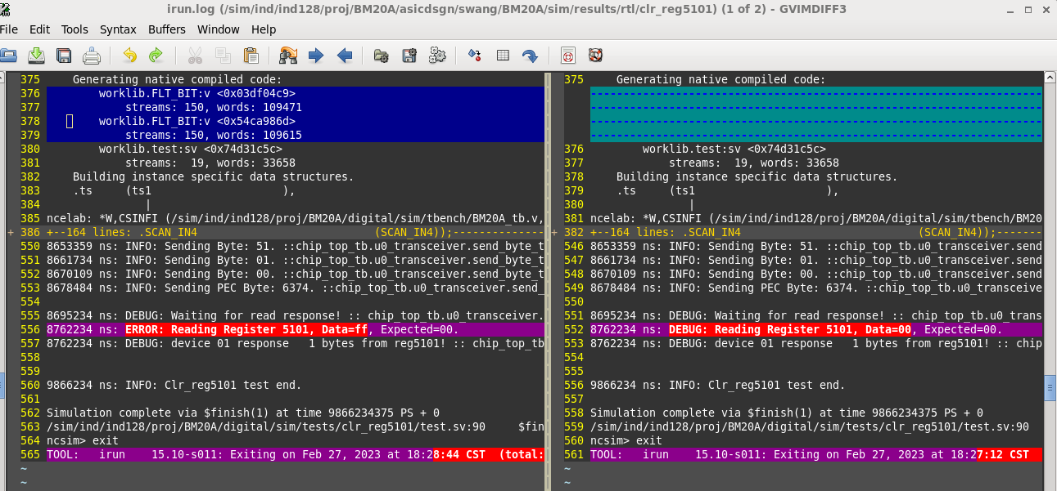
9(issue17) COW_FLT1(0x5101)寄存器无法clear

Slide 13
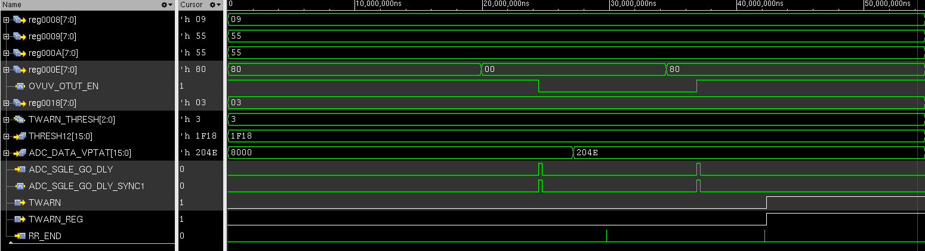
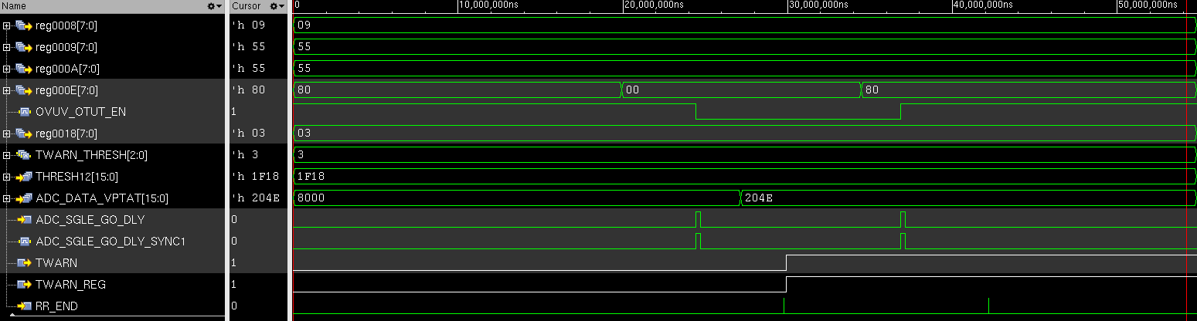
11(issue20) Twarn受OVUV_OTUT_EN bit控制

Slide 14
11(issue20) Twarn受OVUV_OTUT_EN bit控制--代码修改
always@(posedge CLK_SLOW_SC or negedge resetb_SR_CLK_SLOW)
begin
if(~resetb_SR_CLK_SLOW)
CMP_RESULT[(CH_NUM-1'b1):1] <= {(CH_NUM-1'b1){1'b0}};
else if(~OUTEN)
CMP_RESULT[(CH_NUM-1'b1):1] <= {(CH_NUM-1'b1){1'b0}};
else if(CMP_UNDERWAY)
begin
case(cmp_cnt)
5'd2: CMP_RESULT[1] <= cmp_result_rr;
5'd3: CMP_RESULT[2] <= cmp_result_rr;
5'd4: CMP_RESULT[3] <= cmp_result_rr;
5'd5: CMP_RESULT[4] <= cmp_result_rr;
5'd6: CMP_RESULT[5] <= cmp_result_rr;
5'd7: CMP_RESULT[6] <= cmp_result_rr;
5'd8: CMP_RESULT[7] <= cmp_result_rr;
5'd9: CMP_RESULT[8] <= cmp_result_rr;
5'd10:CMP_RESULT[9] <= cmp_result_rr;
5'd11:CMP_RESULT[10] <= cmp_result_rr;
5'd12:CMP_RESULT[11] <= cmp_result_rr;
5'd13:CMP_RESULT[12] <= cmp_result_rr;
// 5'd14:CMP_RESULT[13] <= cmp_result_r;
default:CMP_RESULT[(CH_NUM-1'b1):1] <= CMP_RESULT[(CH_NUM-1'b1):1];
endcase
end
end
always@(posedge CLK_SLOW_SC or negedge resetb_SR_CLK_SLOW)
begin
if(~resetb_SR_CLK_SLOW)
CMP_RESULT[CH_NUM] <= {1'b0};
else if(CMP_UNDERWAY)
begin
case(cmp_cnt)
5'd14:CMP_RESULT[13] <= cmp_result_r;
default:CMP_RESULT[CH_NUM] <= CMP_RESULT[CH_NUM];
endcase
end
end
always@(posedge CLK_SLOW_SC or negedge resetb_SR_CLK_SLOW)
begin
if(~resetb_SR_CLK_SLOW)
CMP_RESULT[CH_NUM:1] <= {CH_NUM{1'b0}};
else if(~OUTEN)
CMP_RESULT[(CH_NUM-1'b1):1] <= {(CH_NUM-1'b1){1'b0}};
else if(CMP_UNDERWAY)
begin
case(cmp_cnt)
5'd2: CMP_RESULT[1] <= cmp_result_rr;
5'd3: CMP_RESULT[2] <= cmp_result_rr;
5'd4: CMP_RESULT[3] <= cmp_result_rr;
5'd5: CMP_RESULT[4] <= cmp_result_rr;
5'd6: CMP_RESULT[5] <= cmp_result_rr;
5'd7: CMP_RESULT[6] <= cmp_result_rr;
5'd8: CMP_RESULT[7] <= cmp_result_rr;
5'd9: CMP_RESULT[8] <= cmp_result_rr;
5'd10:CMP_RESULT[9] <= cmp_result_rr;
5'd11:CMP_RESULT[10] <= cmp_result_rr;
5'd12:CMP_RESULT[11] <= cmp_result_rr;
5'd13:CMP_RESULT[12] <= cmp_result_rr;
5'd14:CMP_RESULT[13] <= cmp_result_r;
default:CMP_RESULT[CH_NUM:1] <= CMP_RESULT[CH_NUM:1];
endcase
end
end

Slide 15
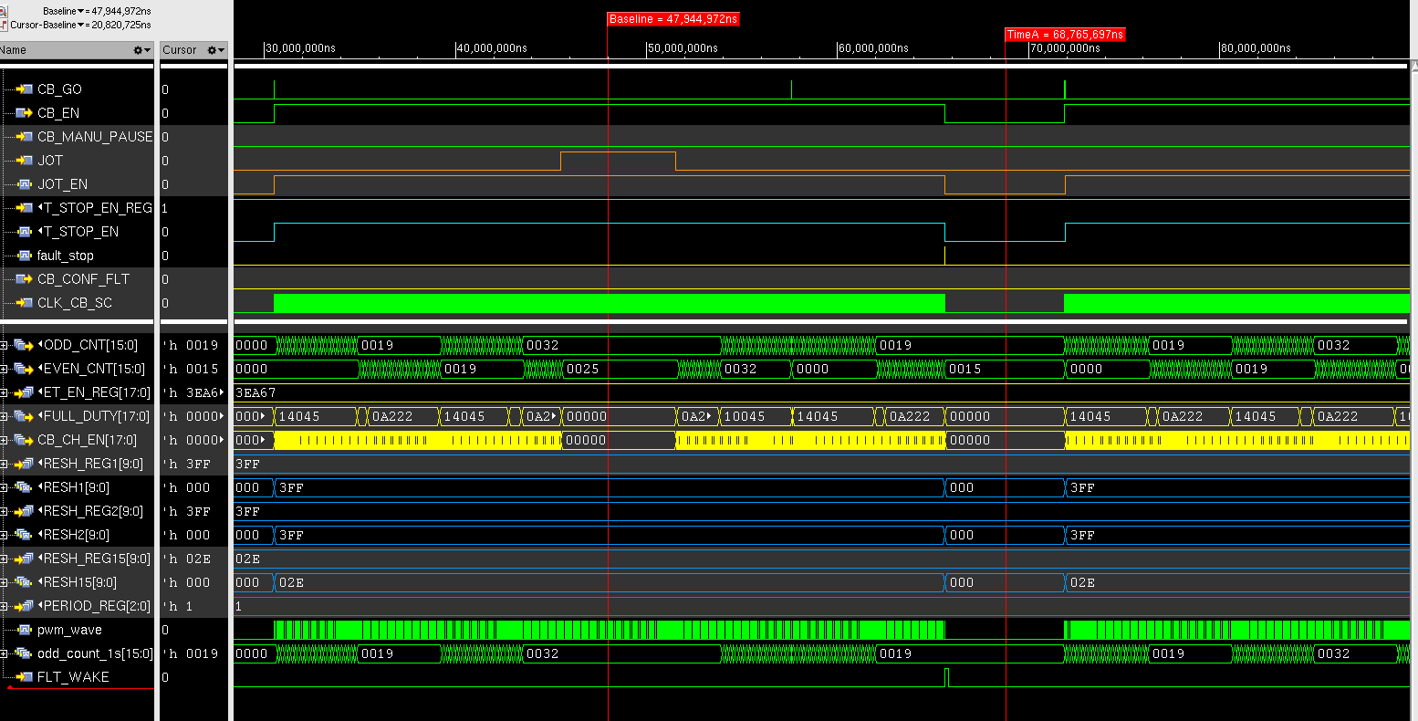
12(issue30) CB_CNT 在发生故障时没有立刻清零（不改）
Before eco

Slide 16
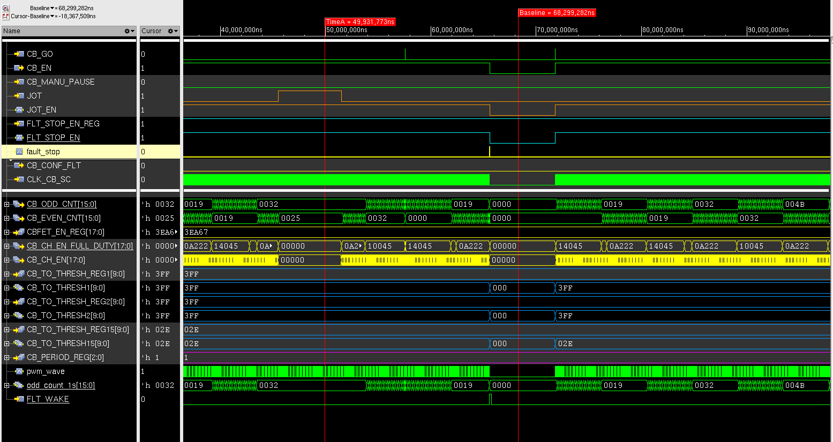
12(issue30) CB_CNT 在发生故障时没有立刻清零
After eco

Slide 17
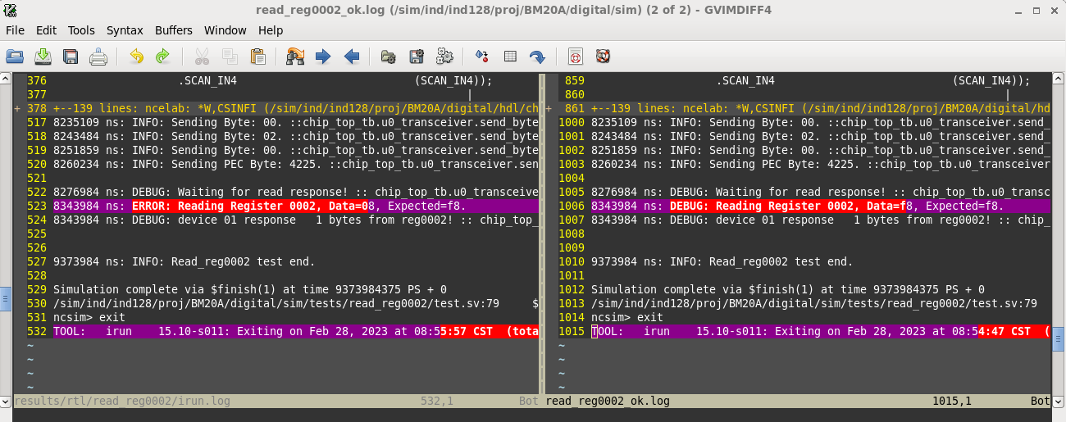
13(issue39) CB_SETTLE[4:0], default value need to change

Slide 18
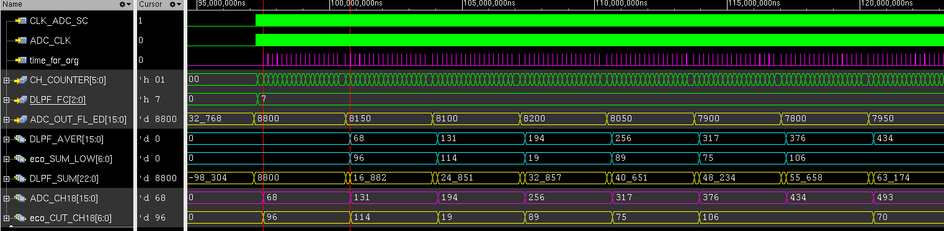
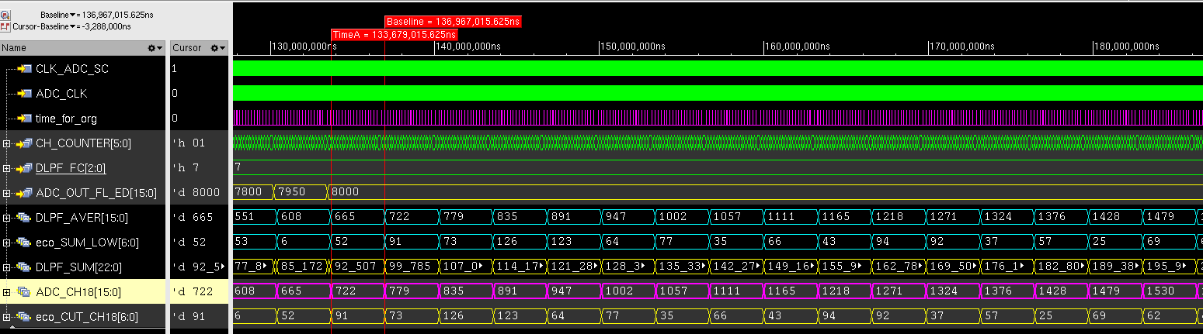
18(issue44) DLPF 算法存在错误，会丢失有效数据导致DLPF后的结果存在误差

Slide 19
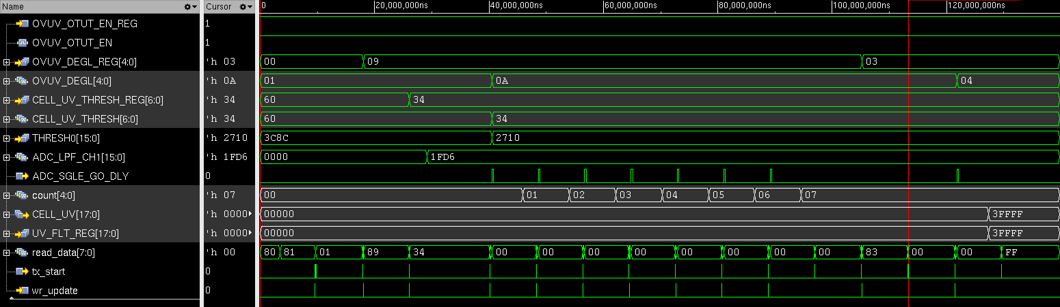
19(issue43)更改UV deglitch的值，不会reset counter的计数

Slide 20
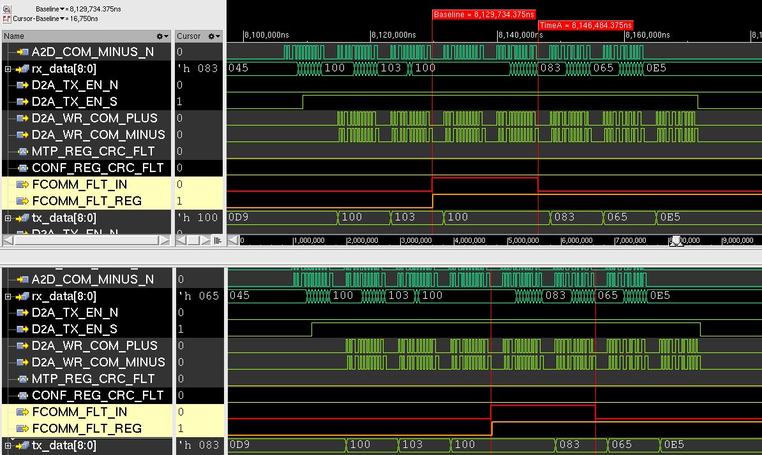
20(issue51) FCOMM的投票机制没错，做成了3选2

Slide 21
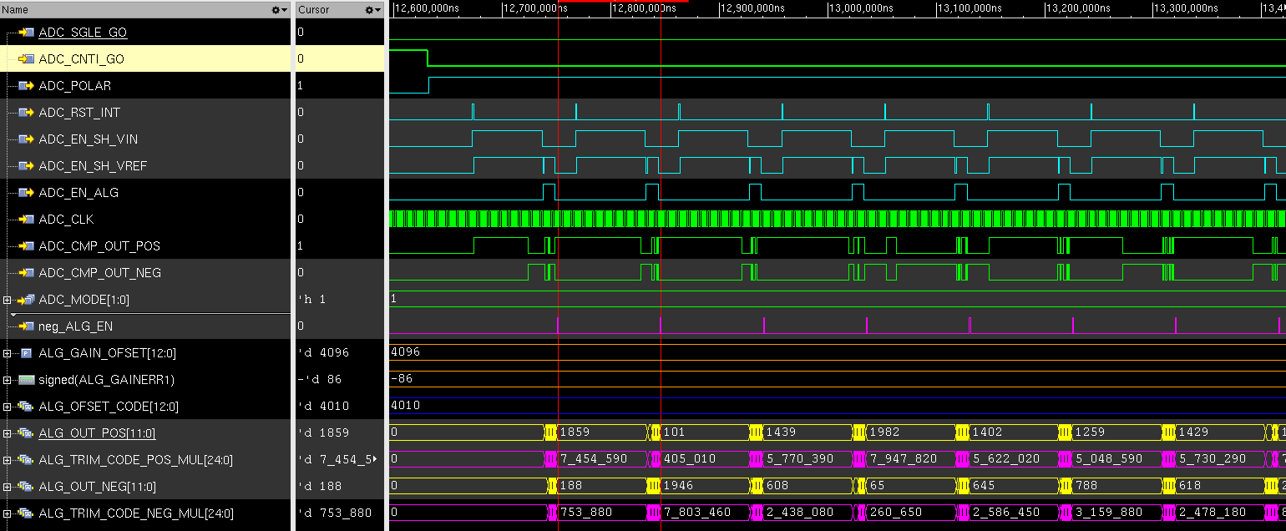
21 ADC_LOGIC中ALG与GAIN_ERR乘法运算符号错误

Slide 22
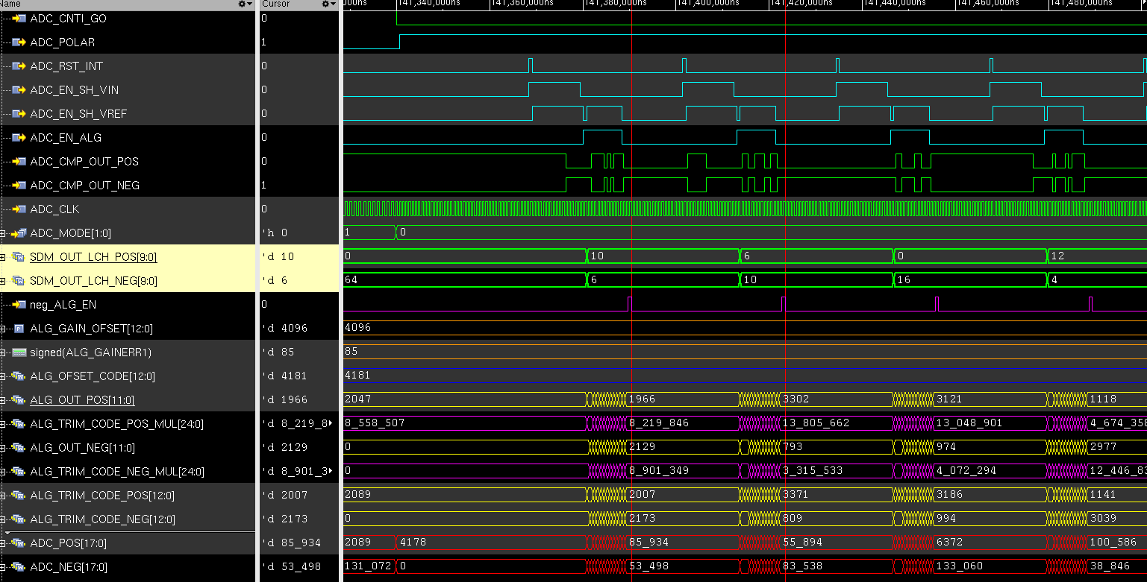
22 ADC_LOGIC中SDM与ALG数据合并在mode为0时缩小了一倍

